Slide 1
Presentation of The Computer
Prepared by:
Mariem Sfaxi

Slide 2
We will discover:
What is a computer ?
What is operating system ?
Components of computer
How to save a folder in a computer ?
Parts of a computer with their functions
How to write an email ?
What is computer Hardware ?
Advantages of Computer
What is computer Software ?
Disadvantages of computer
How do the two (computer hardware and computer software) work together and interact?

Slide 3
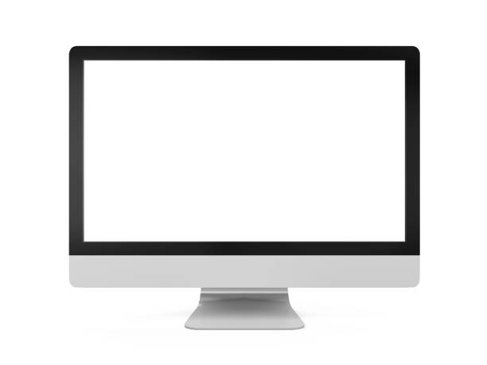
What is a computer ?
A computer is a programmable electronic device that accepts raw data as input and processes it with a set of instructions (a program) to produce the result of output.

Slide 4
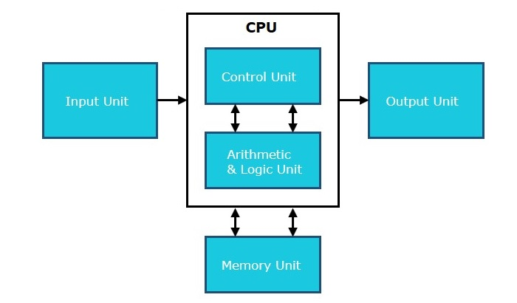
Components of computer

Slide 5
Input Unit
This unit contains devices with the help of which we enter data into the computer. This unit creates a link between the user and the computer.

Slide 6
CPU (Central Processing Unit)
CPU is considered as the brain of the computer.
It performs all types of data processing operations and stores data, intermediate results, and instructions (program).

Slide 7
Output Unit
The output unit consists of devices with the help of which we get the information from the computer.
This unit is a link between the computer and the users.

Slide 8
Parts of a computer with their functions

Slide 9
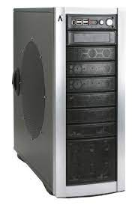
1. The computer case
This is the part that holds all of the internal components to make up the computer itself.
It is usually designed in such a manner to make fitting a motherboard, wiring, and drives as easy as possible.

Slide 10
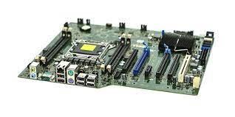
2. Motherboard
The motherboard is the main board that is screwed directly inside the computer case.
Its function is to integrate all the components so they can communicate and operate together.

Slide 11
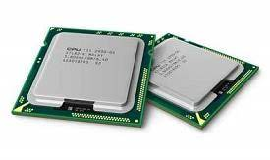
CPU: Central Processing Unit
The CPU is basically like the brain of a computer.
It processes all the information on a computational level.
It takes information from the RAM and processes it to perform the tasks required from the computer.

Slide 12
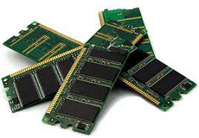
4. RAM: Random Access Memory
RAM is a data storage device that can provide fast read
and write access.
It is also volatile, which means that it loses all the stored data when power is lost.

Slide 13
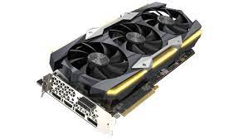
5. Graphics Card
A Graphics Card processes the data from the motherboard and sends the appropriate information to the monitor for it to be displayed.
It can do so using an HDMI, DisplayPort, DVI, or VGA connector.

Slide 14
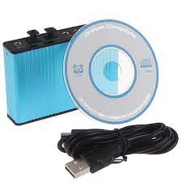
6. Sound Card
Sound cards plug into a computer in multiple ways. It can be through USB, PCI slot, or PCI Express x 1 slot.

Slide 15
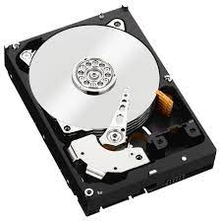
7. Hard Drive
A hard drive is found in most computers. It’s usually a mechanical drive that stores all the data.
Apart from storing data, it can also be used as a boot drive to run the operating system from it.

Slide 16
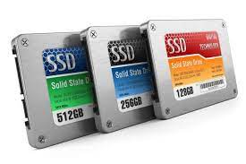
8. SSD: Solid State Drive
An SSD is also a type of hard drive, but it doesn’t have any moving parts.
It consists of a bank of flash memory that can hold a reasonable amount of data.

Slide 17
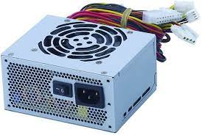
9. PSU: Power Supply Unit
A power supply mounts inside the computer case.
This converts the AC mains supply from the wall socket and supplies the correct DC voltages to all the components inside the computer.

Slide 18
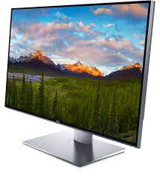
10. Monitor
A monitor is what you use to visualize the graphics data sent from the computer’s graphics card.
There are various types of monitors on the market. The most commonly used is a LED-backlit LCD monitor.

Slide 19
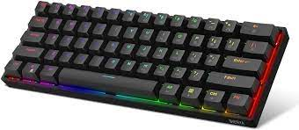
11. Keyboard
A keyboard is one of the ways to communicate with a computer.
Typing a key from the keyboard sends a small portion of data to tell the computer which key was pressed.

Slide 20
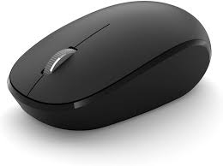
12. Mouse
A mouse allows the user to move a pointer displayed on the monitor and experience a more intuitive interaction with the computer.

Slide 21
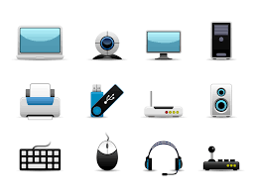
What is computer Hardware ?
Quite simply, computer hardware is the physical component that a computer system requires to function. It encompasses everything with a circuit board that operates with a PC or laptop, including graphics card, central processing unit and webcam.

Slide 22
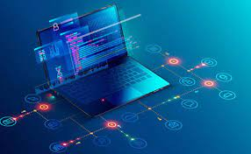
What is computer Software ?
Computer Software is programming code executed on a computer processor. The code can be machine-level code or code written for an operating system.

Slide 23
How do the two (computer hardware and computer software) work together and interact?
Each of them should work a long to form computer produce a helpful output.
We can say that the hardware and software are the heart and soul of a digital computer.

Slide 24
What is operating system ?
It is an interface between a computer user and computer hardware.
It is a software which performs all the basic tasks like file management, memory management and controlling peripheral devices such as: disk drives and printers.

Slide 25
How to save a folder in a computer ?
With your document open, click file -> Save as
Under save as, select where you want to create your new folder
In the save as dialog box that opens, click new folder.
Type the name of your new folder and click enter.
Click save.

Slide 26

How to write an email ?
Let's watch this video with some simple tips.

Slide 27
Here are six steps to write a professional email:
Identify your goal: Start by asking yourself what you want the recipient to do after they have read it.
Consider your audience: When you compose an email message, make sure your tone matches your audience.
Keep it concise: Make it as brief as possible without leaving out key information.
Proofread your email: Take a moment to check for any spelling, grammar, or syntax error.
Use proper etiquette: Include a courteous greeting and closing to send friendly and polite.
Remember to follow up: If the recipient hasn’t replied within two working days, consider reaching back out with a friendly flow up email.

Slide 28
Advantages of Computer
1.Speed: Now computer isn’t just a calculating device. Nowayds, computer has vital role in human life. One of the most advantages of computer is its incredible speed, which helps human to finish their task in few seconds.
2.Accuracy: One among the basis advantage of computer is which will perform not only calculations but also with accuracy.
3.Data Security: Protecting digital data is understood as data security.

Slide 29
4.Communication: Computer helps the user in better understanding and communication with the other devices.
5.Productivity: The level of productivity gets automatically doubled as the computer can done the work at very fast.
6.Reduces work load: Informations are often accessed by more then one person with the necessity for work to be duplicated.
7.Storage: The pc has an in-built memory where it can store an outsized amount of knowledge . You can also store data in auxiliary storage devices.

Slide 30
Disadvantages of computer :
Virus and hacking attacks: Virus may be a worm and hacking is just an unauthorized access over computer for a few illicit purpose.
2.Reduction employed opportunity: Mainly past generation wasn’t used of the pc, or they need the knowledge of computer they faced a big problem when computer came in field.
3.Online Cyber Crimes: Online cyber-crime means computer and network may have utilized in order to commit crime.

Slide 31
4.High cost: Computers are expensive. Even the foremost affordable computers are still very expensive for the typical person in South Africa. Since computers empower people.
5.Increases waste and impacts the environment: With the speed that computers and other electronics get replaced, all of the old devices that get thrown away have a big impact on the environment.
6.Distractions/disruptions: If you’ve got ever spent hours browsing the web or watching videos on YouTube, then you recognize how distracting computers can be! Because of their high entertainment value.

Slide 32
We hope you liked the content
THANK YOU FOR YOUR ATTENTION !
Any Questions ?

